Slide 2

Angular Architecture & Fundamentals

Slide 3
Agenda
Architecture
Module
Component
Template
MetaData
Data Binding
Directive
Services
Dependency Injection
Pipes

Slide 4
Angular Architecture
Angular is a platform and framework which is used to create client's applications in HTML and Typescript. Angular is written in Typescript. Typescript is a super-set of JavaScript.
Angular implements core and optional functionality as a set of Typescript libraries which we can import in our application.
NgModules are the basic building blocks of Angular application. They provide a compilation context for components.
Angular always has at least a root module which enables bootstrapping.

Slide 5

Angular Architecture
Various units are combined to build an angular application, which is as follows.
Module
Component{}
Module
Service{}
MetaData
Module
Value 3.1415
Module fn
Template
< >
Directive{}
Property
Binding
Event
Binding
Injector
Component
{ }
Service
{ }

Slide 6
Angular Architecture
These are the essential modules which are as follows:
Module
Component
Templates
Angular
MetaData
Data Binding
Directive
Services
Dependency Injection

Slide 7
Modules
In Angular a module is a set of related components, which may be defined for specific functionality in the application domain.
Every Angular application has a root module, conventionally called the AppModule, which provides a bootstrap mechanism that launches the application. Angular Application is typically made up of sets of functional modules.
Just like in Core JavaScript modules, NgModules can import functionalities from other modules and also export its functionalities. A good example is the Router module, which is imported when the route service is required in our application.
By carefully organizing our applications into modules, some features like Lazy loading can easily be implemented.

Slide 8
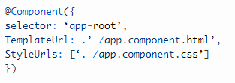
Component
Every angular project has at least 1 component, the root component, and the root components connect the component with a page Document Object Module (DOM). Each component defines a class which contains data, application, logic, and it is binding with the HTML template.

Slide 9

Templates
The angular template integrates the HTML with Angular mark-up that can modify HTML elements before they are displayed. It provides program logic, and binding mark-up connects to application data and the DOM.
In the above HTML file, we have been using a template. We have used the pipe inside the template to convert the values to its desired output.
Root Component{}
Root template
<>
Child A Component
Child A Template
Child B Component
Child B Template
Grandchild
Template
Grandchild
Template

Slide 10
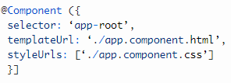
Metadata
Decorators are the metadata in Angular. It is used to enhance the class so it can configure the expected behavior of a class. Developers are the core concept of when developing with Angular. User can use metadata in a class to tell Angular app that app component is a component. Metadata can attach to the Typescript through the decorator.

Slide 11
Data Binding
Angular allows communication between a component and a DOM. Making it very easy to define interactive application without pulling and pushing the data.
There are two types of data binding.
Event Binding: Our app responds to user input in the target environment by updating our application data.
Property Binding: It interpolates values that are computed from application data into the HTML.

Slide 12
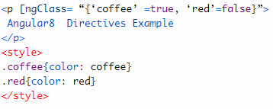
Directives
Directives used for expanding the functionality of HTML elements.
Three types of directives in Angular are
Structural Directive,
Attribute directive and
Component directives.
We can build in Angular directives like: ngClass which is a better example of excising angular attribute directive.

Slide 13
Services
Services used to reuse the code. This service creates for that code which code is standard for more than one component. The decorator provides the meta-data that allows our services to be injected into the client component as a dependency. Angular distinguishes an element from service to increase modularity and re-usability. By separating component functionality from other kinds of processing, we can make our component leaner and more efficient.

Slide 14
Dependency Injection
It is a design pattern for efficiency and modularity. DI is wired into Angular into an Angular framework and used everywhere to provide new component with new services. Dependency injection does not fetch data from a server, validate the user input, or log directly to console; instead, they delegate such tasks to the service.

Slide 15

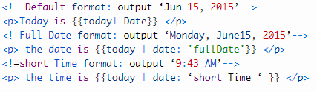
Pipes
A class with the @Pipe decorator defines a function which transforms an input value to output value for display in an amount.
Angular defines various pipes like data pipe and currency pipe; for a complete list and we can also define new pipes. To specify a value transformation in a HTML template, use the pipe operator (|).
A pipe can also take dispute that control how performs its transformation so that we can pass the desired output in the pipe.

Slide 16
THANK YOU

